Slide 1

LiveCap Cover
By Izo & Shai

Slide 2
Overview
We describe what we did. More detailed description of the original work of LiveCap can be found in the report.
This presentation builds on the ideas bottom up, first we describe the individual components, then how they are joined together.

Slide 3
Road map:
Overview
Problem Description
Human 3D Modeling
Non-Linear Least Squares (NLLS) Optimization
Image Processing
Combining it all
Implementation
Experiments
Main Differences From The Original Work
Conclusions & Future Work

Slide 4
2. Problem Description

Slide 5
Real Time Motion Capture
Our task is to capture the movement of a human from a video.
To Capture The Movement in our context means to recreate a 3d model that moves similarly to the human observed in the images.
Different uses: game industry, medical world...

Slide 6
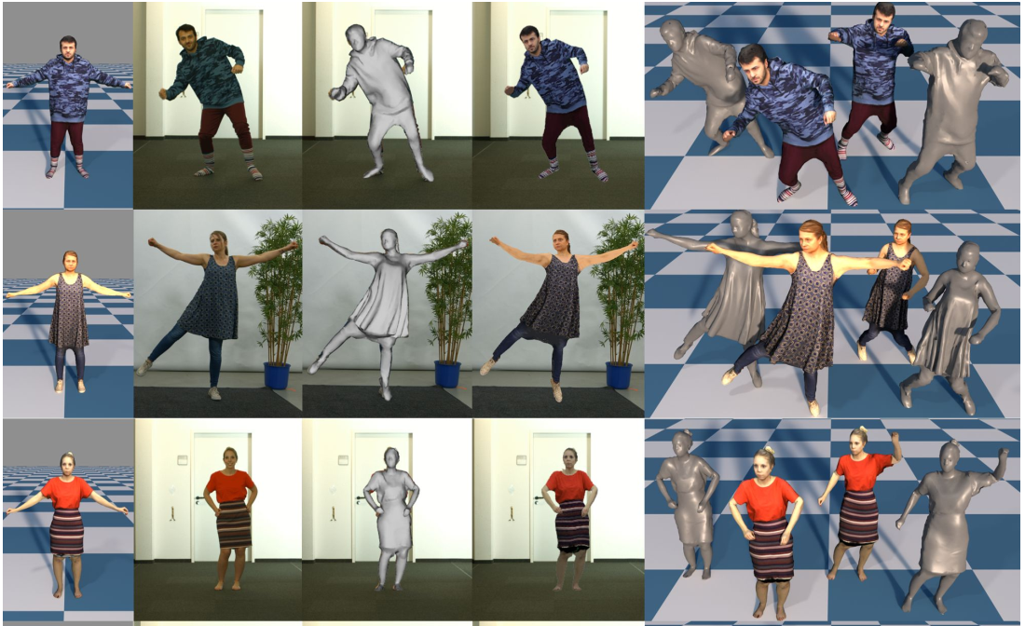
Left to right
The model in the rest pose
Input image
Model without texture
Model with texture
Textured and untextured model from different views
Motion capture - from livecap paper

Slide 7
3. Human 3d modelling

Slide 8
Representing Geometrical Shapes
This is done by approximating the shape with many small polygons - a Mesh.
The polygons here are called Faces, and are here triangles.
Each face is composed out of vertices, connected by edges.
Vertices are points in 3d space.

Slide 9
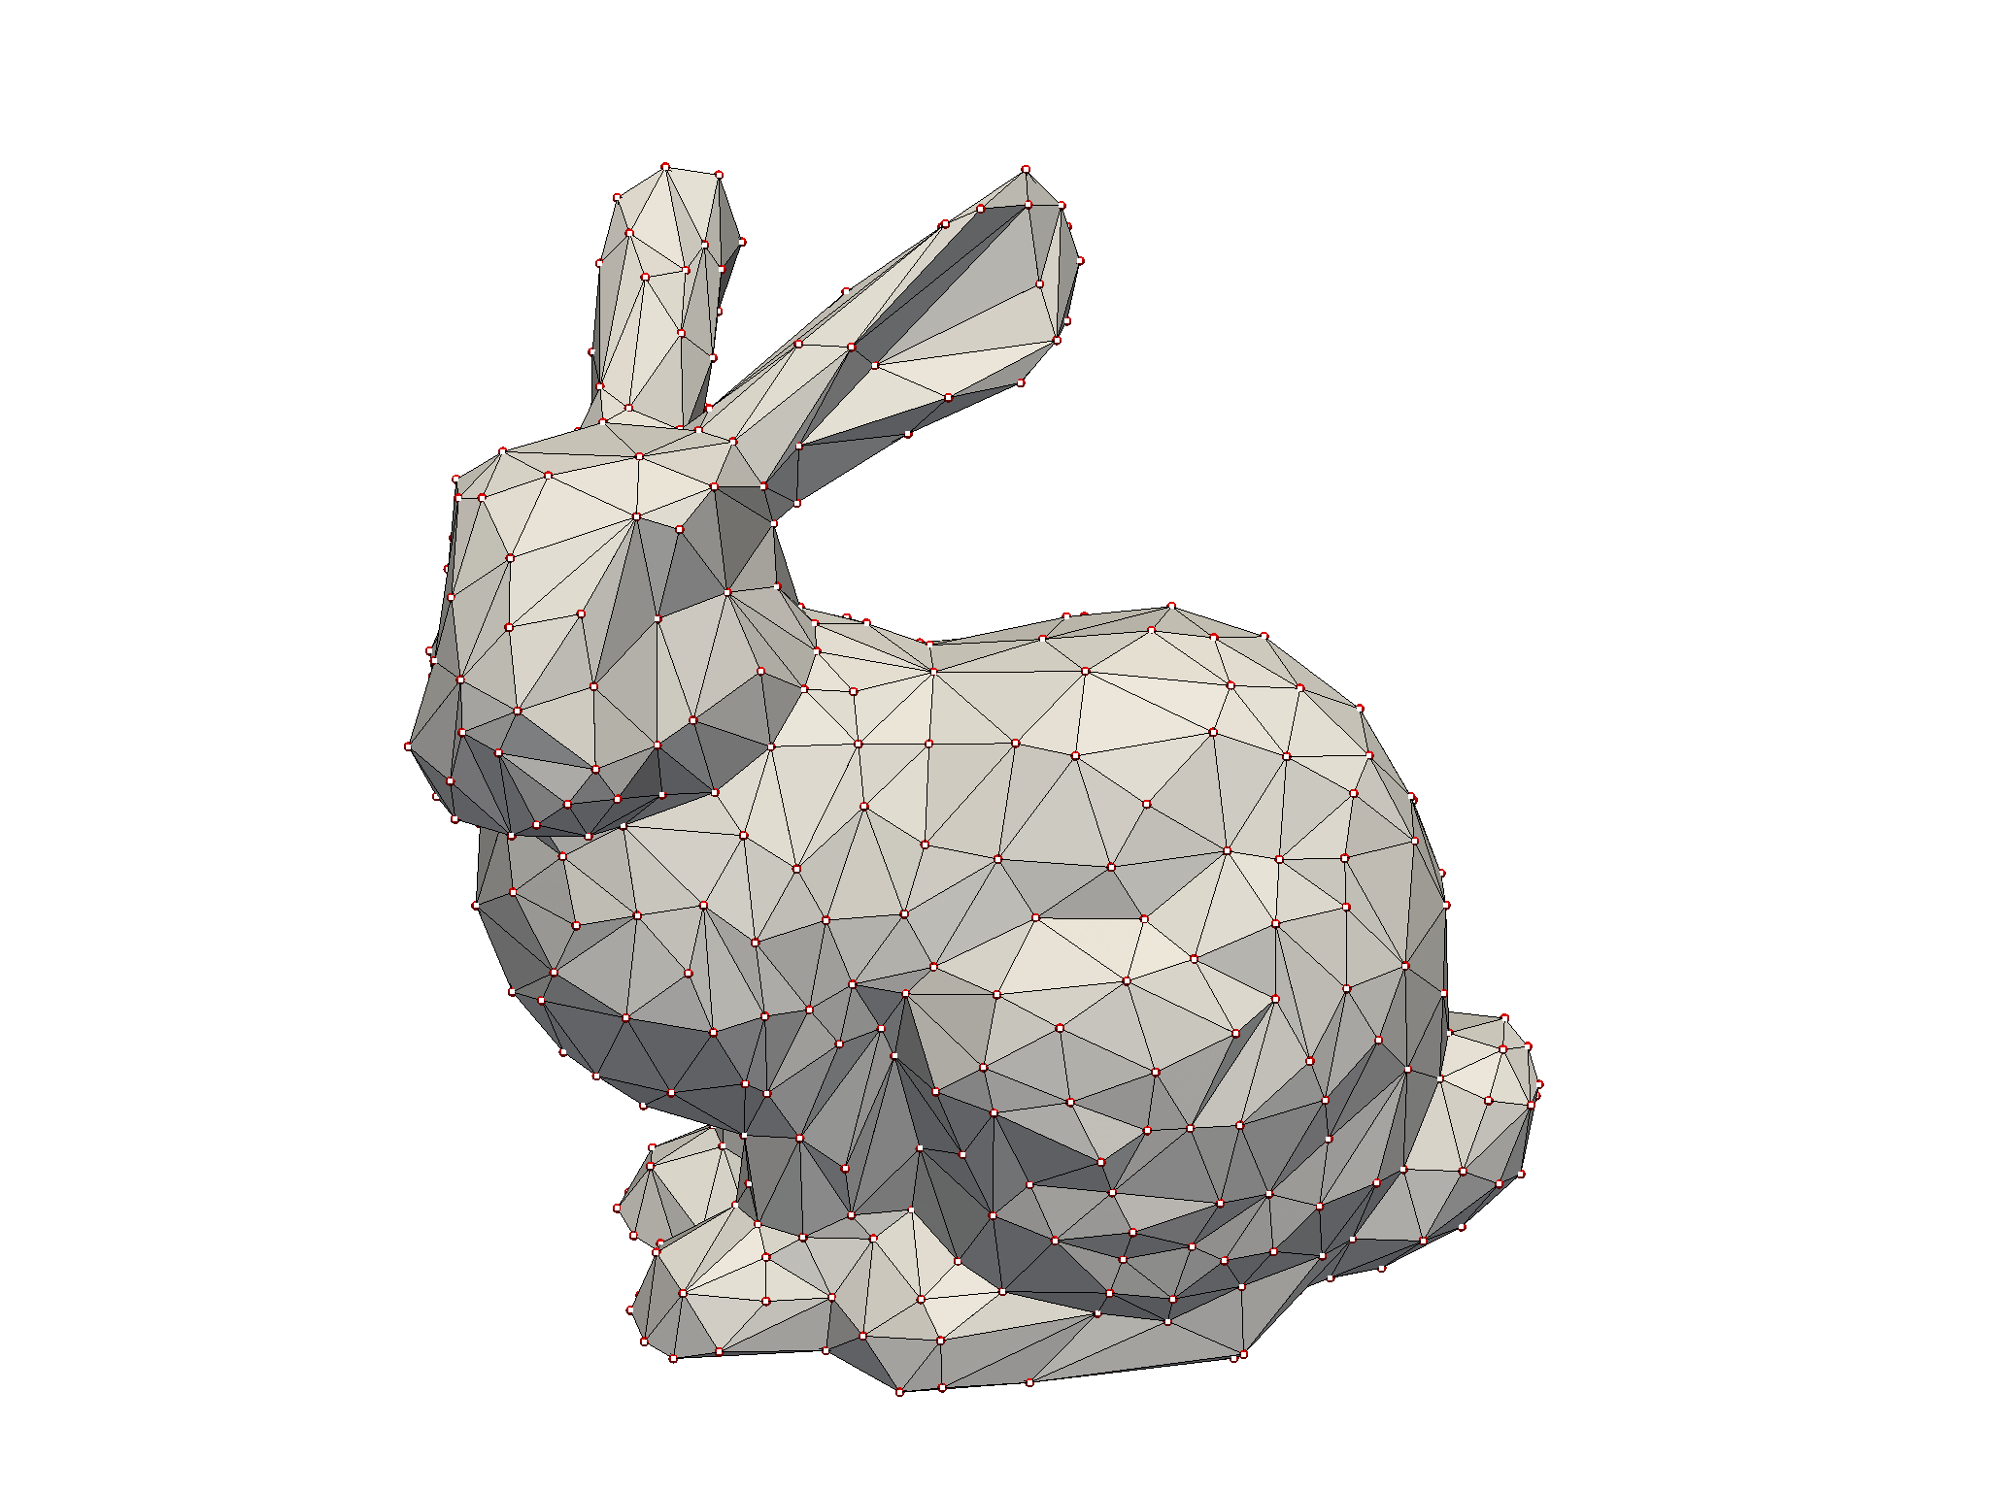
3d mesh - can see vertices, faces, edges - from pyvista docs

Slide 10
Movement Model
We use a movement model called Linear Blend Skinning (LBS).
We have a skeleton that is an hierarchical set of joints.
Each joint has a parent (or is the root), and a set of transformations.
T_joint_to_parent is the rigid transformation from a joint to its parent joint.
T_joint_to_model is a transformation from the joint space to the model space.
T_model_to_joint is a transformation from the model space to joint space.

Slide 11
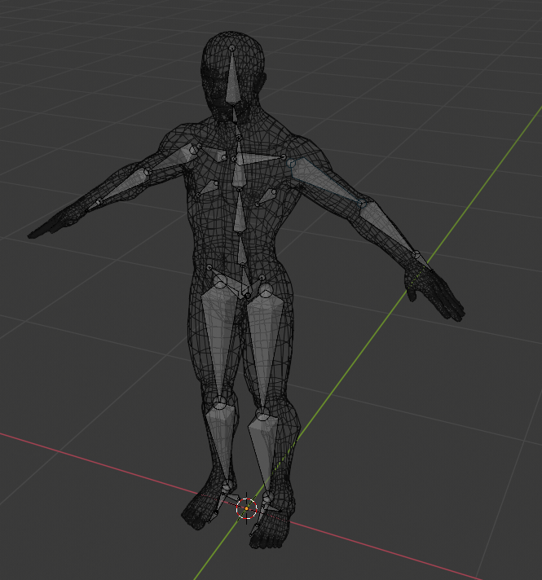
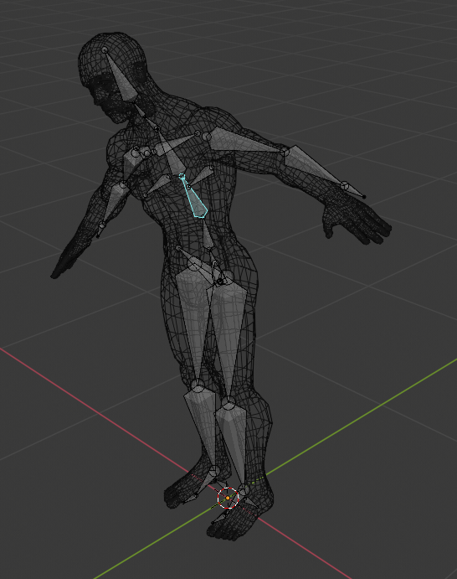
Skeleton Movement - a single joint movement(spine) affects all its children - blender

Slide 12
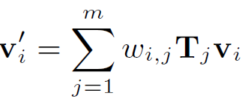
Movement Model (cont.)
Each vertex, joint pair has an associated weight, s.t. All of the weights associated with that vertex are summed up to 1.
weight(i,j) means, how much vertex v_i is affected by joint j.
Most of the weights are 0.

Slide 13
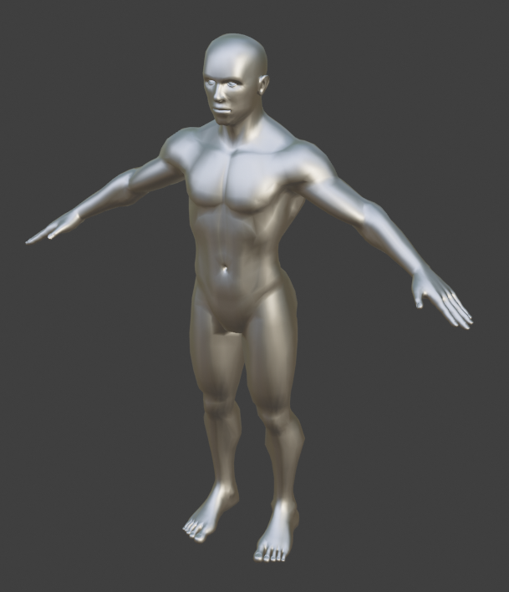
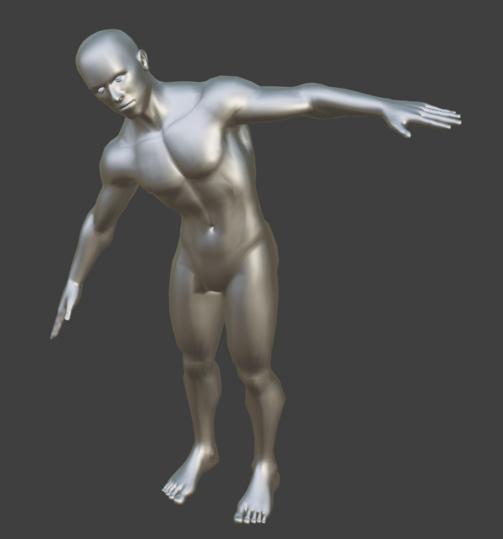
Same model shape change after the rotation of the spine joint - blender

Slide 14
4. Non-Linear least squares optimization

Slide 15
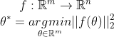
NLLS
Least Squares is a minimization problem, where we have some vector function f, that we try to find the argument to this functions that yields the minimum value in terms of the L2 norm:

Slide 16
NLLS (cont.)
When f is a linear function, we have a closed form solution.
When f is non-linear, we usually iteratively solve for the optimal parameters, by using first(linear) or second (quadratic) approximations.
There are many methods for solving NLLS, the paper uses Gauss-Newton method, we use Levenberg–Marquardt.
To use NLLS solvers, we need to formulate our problem with a vector valued cost function, that is f.

Slide 17
5. Image processing

Slide 18
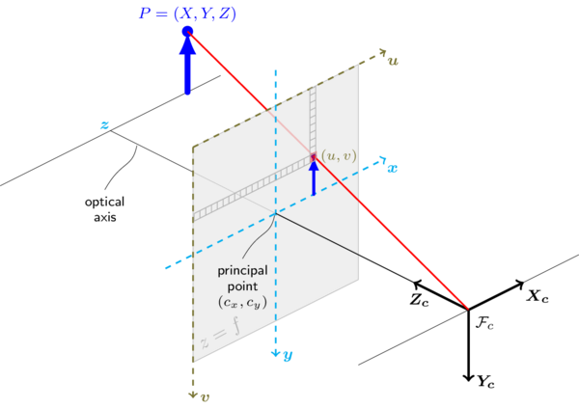
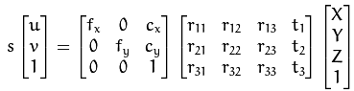
Projection and camera calibration
Camera model parameter
The projection operator
A
R|t
A - intrinsic parameters, camera matrix R - extrinsic parameters
Camera calibration: finding A

Slide 19
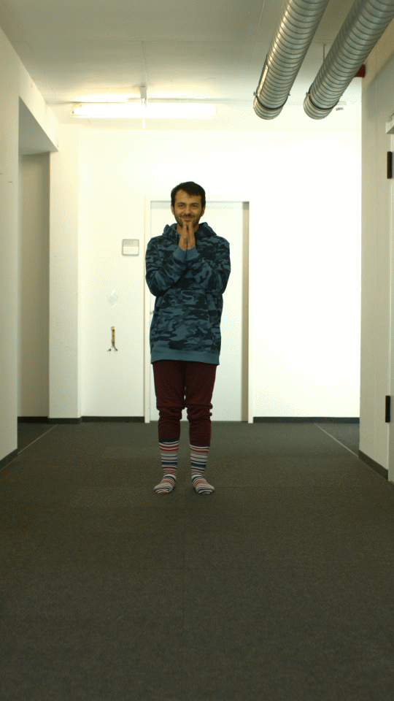
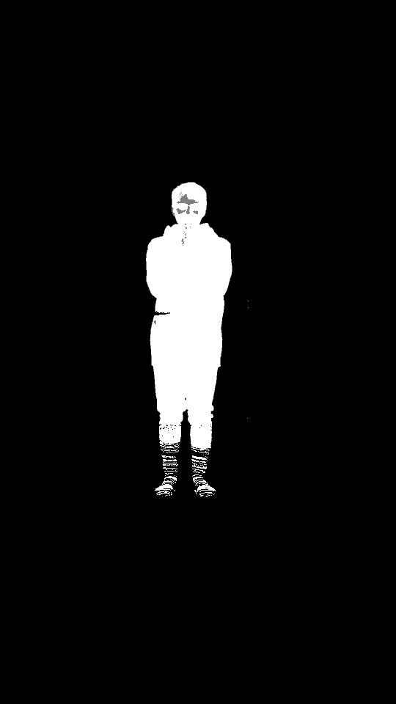
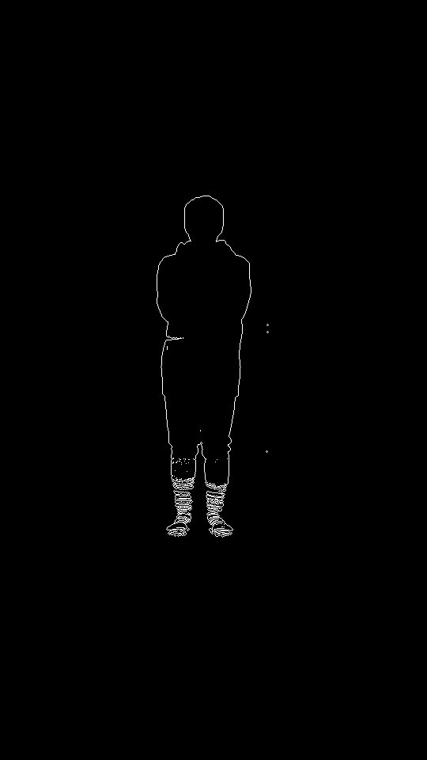
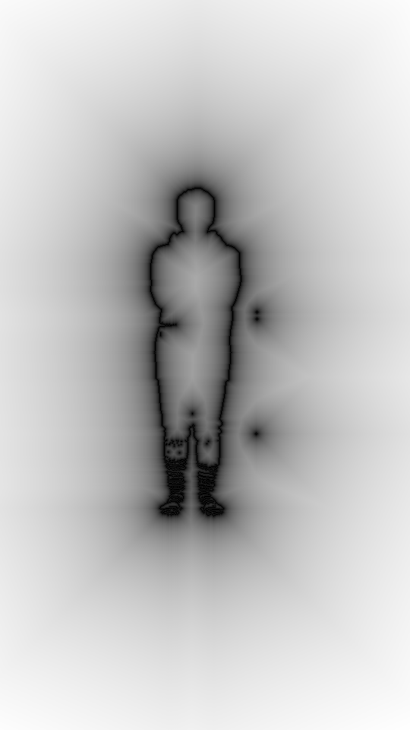
Silhouette extraction
Background subtraction
Silhouette extraction using Laplacian operator
Image Distance Transform
Input image
Foreground mask
silhouette
IDT (logscaled)

Slide 20
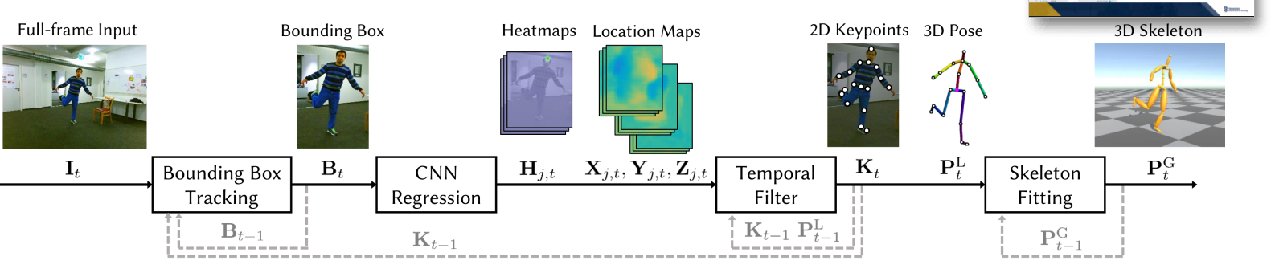
3d & 2D pose estimation
VNECT
Input: sequence of monocular images
Output: 2d and 3d joint positions
Image is passed through a CNN, producing heatmaps
Heatmaps are passed through a temporal filter and skeleton fitting stage

Slide 21
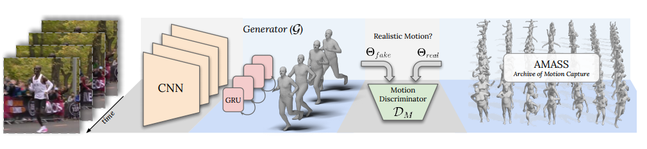
3d & 2D pose estimation
VIBE
Input: sequence of monocular images
Output: SMPL body shape and pose parameters (~90).
The input is passed through a CNN feature extractor
Features are combined over time using RNN
Training uses additional Discriminator to make sure that the output parameters are realistic.

Slide 22
6. Combining it all

Slide 23
Combining It All
We formulate our problem as a NLLS.
The parameters that we optimize are the root rigid transformation and the joints angles.
We use our Motion Model and the outputs of the Image Processing to define our cost function, also called Energy.

Slide 24
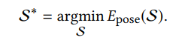
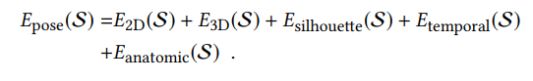
Energy
The parameters to the energy is the root translation + rotation + joint angles.
Is composed of different parts, those are derived either from matching our model to the current frame(silhouette, 3d, 2d), or based on prior knowledge on the movement of humans(temporal, anatomic).
For each part we add weights to balance.

Slide 25
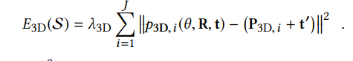
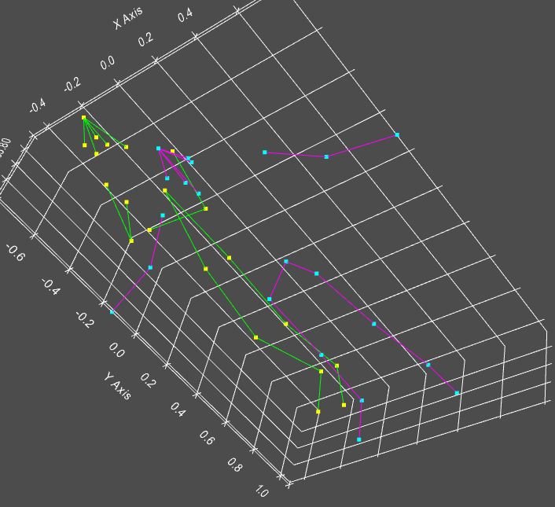
The difference between the predicted 3d joint positions and the models 3d joint positions

Slide 26
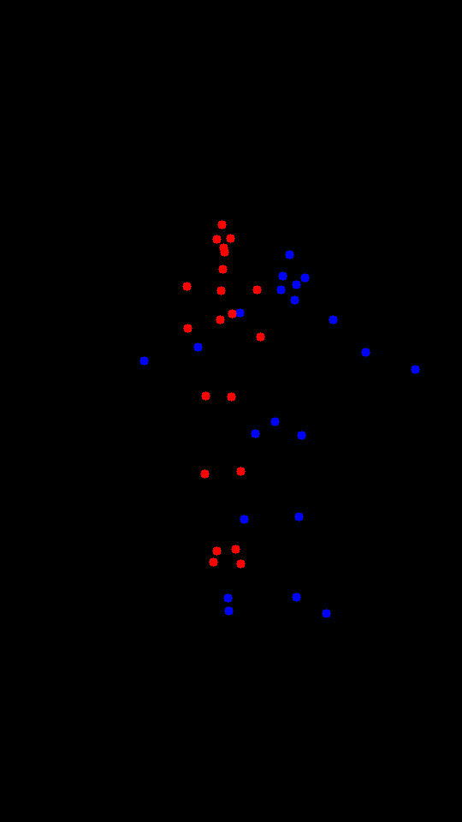
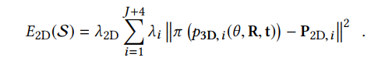
The difference between the predicted 2d joint positions and the projected model’s joints

Slide 27
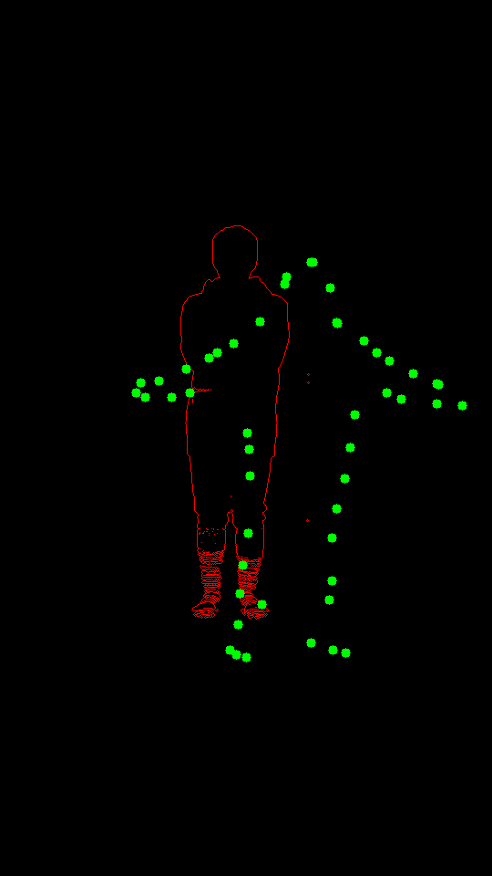
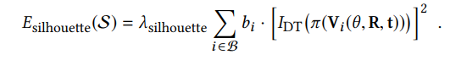
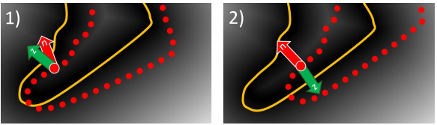
The distance transform of the silhouette at the pixels of the projected contour vertices.
The b in the formula is a special term to give us the correct sign when the point is inside the silhouette

Slide 28
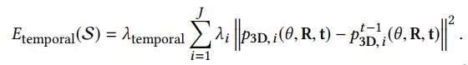
This is the difference in the model’s joint position w.r.t the previous frame estimated pose.
This can also be interpreted as the velocity of the joint.

Slide 29
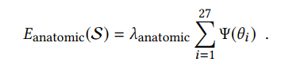
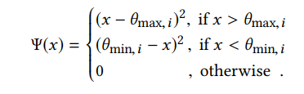
For each joint angle we have an upper and a lower limit.
If we pass one of those limits, then we add the difference to the energy of the pose.

Slide 30
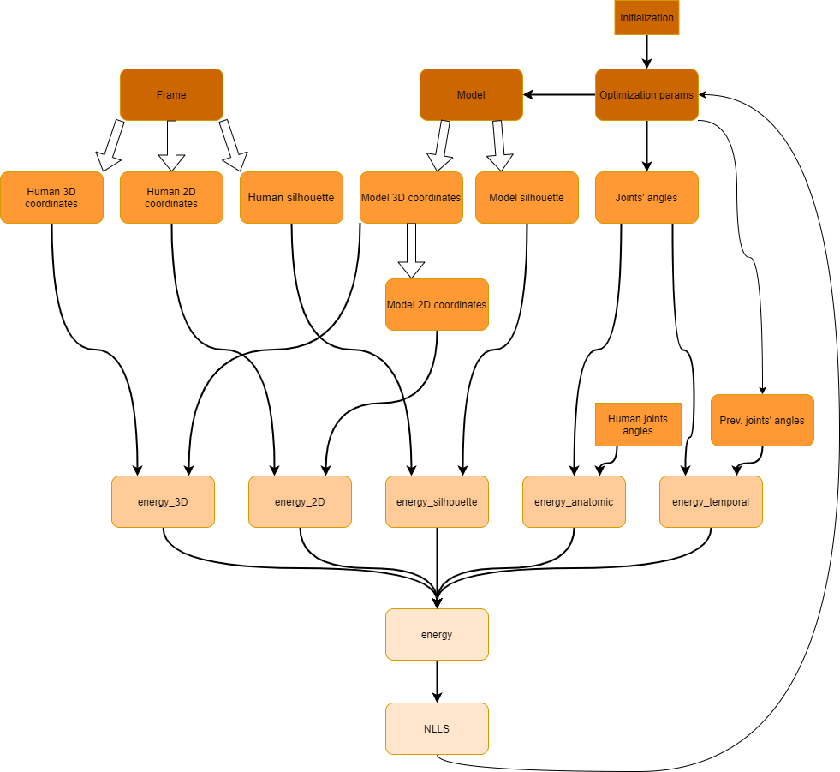

Slide 31
7. Implementation

Slide 32


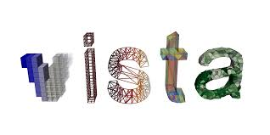


Implementation - code and packages
Anaconda package manager
Github for collaboration
Python 3.7 - surprisingly fast when used correctly.
Numpy 1.17 - fast array operations
Scipy 1.4 - NLLS solvers and rotations
OpenCV 4.1 - part of the image processing
Pytorch 1.4 - VIBE
Pyvista 0.25 - visualizations
Pycollada 0.4 - 3d I/O
...

Slide 33
8. Experiments

Slide 34
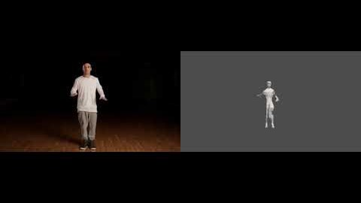
Exp. 1 - Dance + generic model
For development and testing we used a video downloaded from youtube + a generic human body rigged with blender

Slide 35
Exp. 1 - Conclusions
Can see that the blending weights are not good, and create some unnatural movement.
Large number of vertices slows down the optimization.
Large number of DOFs (3 for each joint) slows down optimization, and leads to some of the unnatural movement.
Still it kind of works.

Slide 36
Exp. 2 - Original video + model:
Here we used the resources shared by livecap authors, after we had troubles creating our own models.

Slide 37
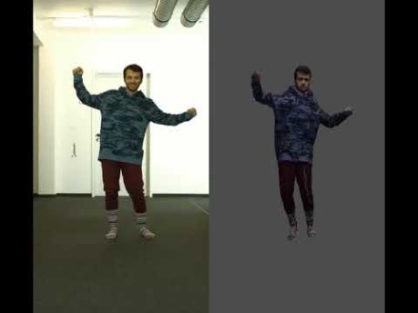

Slide 38
Exp 2. Conclusions
The results look much more satisfying.
Reducing the number of vertices from ~19,000 to ~5,000 and reducing the number of DOFs from ~90 to ~30 greatly improved the runtime speeds, getting to almost real time speeds on a pc alone.
Some mismatch exists in the mapping from predicted joint locations and model joint location, the results of this can be seen in the video.
The predictions are a little bit jittery, this might be to due low weight of the temporal energy.

Slide 39
Exp 3. Balancing the energies
We tried changing the balances between the different energies and even dropping some of them.
Experiment / Weight | 3d | 2d | silhouette | temporal | anatomic
0. Baseline | 1 | 1e-3 | 1e-3 | 0.1 | 0.5
1. No silhouette | 1 | 1e-3 | 0 | 0.1 | 0.5
2. High anatomic + temporal | 1 | 1e-3 | 1e-3 | 1 | 2
3. No Anatomic + temporal | 1 | 1e-3 | 1e-3 | 0 | 0
4 No 3d | 0 | 1e-3 | 1e-3 | 0.1 | 0.5
5. No 2d + silhouette | 1 | 0 | 0 | 0.1 | 0.5

Slide 40
Exp 3. Sample results
No 3d loss
No 2d and silhouette loss
No regulation (anatomic + temporal)

Slide 41
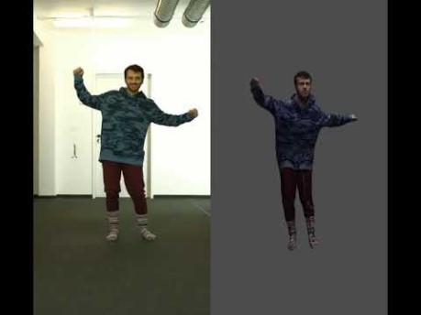
No 3d Loss

Slide 42

2. No 2d and silhouette

Slide 43

3. No Regulation

Slide 44
Exp 3. Conclusions
Dropping 3d cost significantly reduces the quality of the results
Dropping both 2d and silhouette cost is not as significant
Dropping the regulatory terms in the cost results in unnatural movement

Slide 45
9. Differences From the Original Work

Slide 46
Differences
The paper also goes through the model acquisition stage and the non-rigid optimization stage. We did not recreate that due to a lack of time.
We choose to use Python. The programing language use by the authors is not clearly stated, but we estimate that it was a combination of C++ and MATLAB.
We did not get real-time results, mainly because we run without gpu, and of the frameworks used.
We used VIBE instead of VNECT, because we were not able to run it in our computers.

Slide 47
10. Conclusions & Future Work

Slide 48
Conclusions & Future Work
The importance of making your implementation publicly available
3 separate parts - pose estimation, skeleton optimization and model rigging, maybe letting them benefit from each other might prove useful, for example:
using the pose estimation module to automatically rig the model
fine tuning the pose estimation model using the optimization results to the specific model, to reduce the number of iterations
Implementing the non-rigid deformation might yield farther insight.

